Slide 1
Does Cocoa Certification Improve Lives?
By
King Carl Tornam Duho
RP Workshop: February 21, 2024

Slide 2
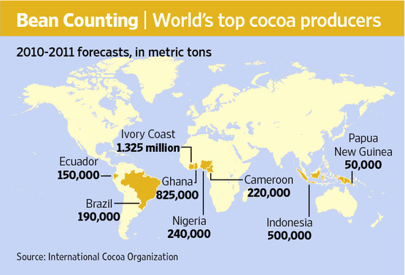
Motivation
Cocoa market is valued at ~ US$46.61 billion
Cocoa value chain is broad ranging from producers to the consumer, with each country having different players
Farming has been linked to unsustainable practices and calls for sustainable sourcing from chocolatiers
Globally, cocoa farmers’ earnings in the global cocoa value is 6% and there are concerns about poverty levels of the cocoa farmers
Notes:
https://www.wsj.com/articles/SB10001424052748704083904576335483381742692

Slide 3
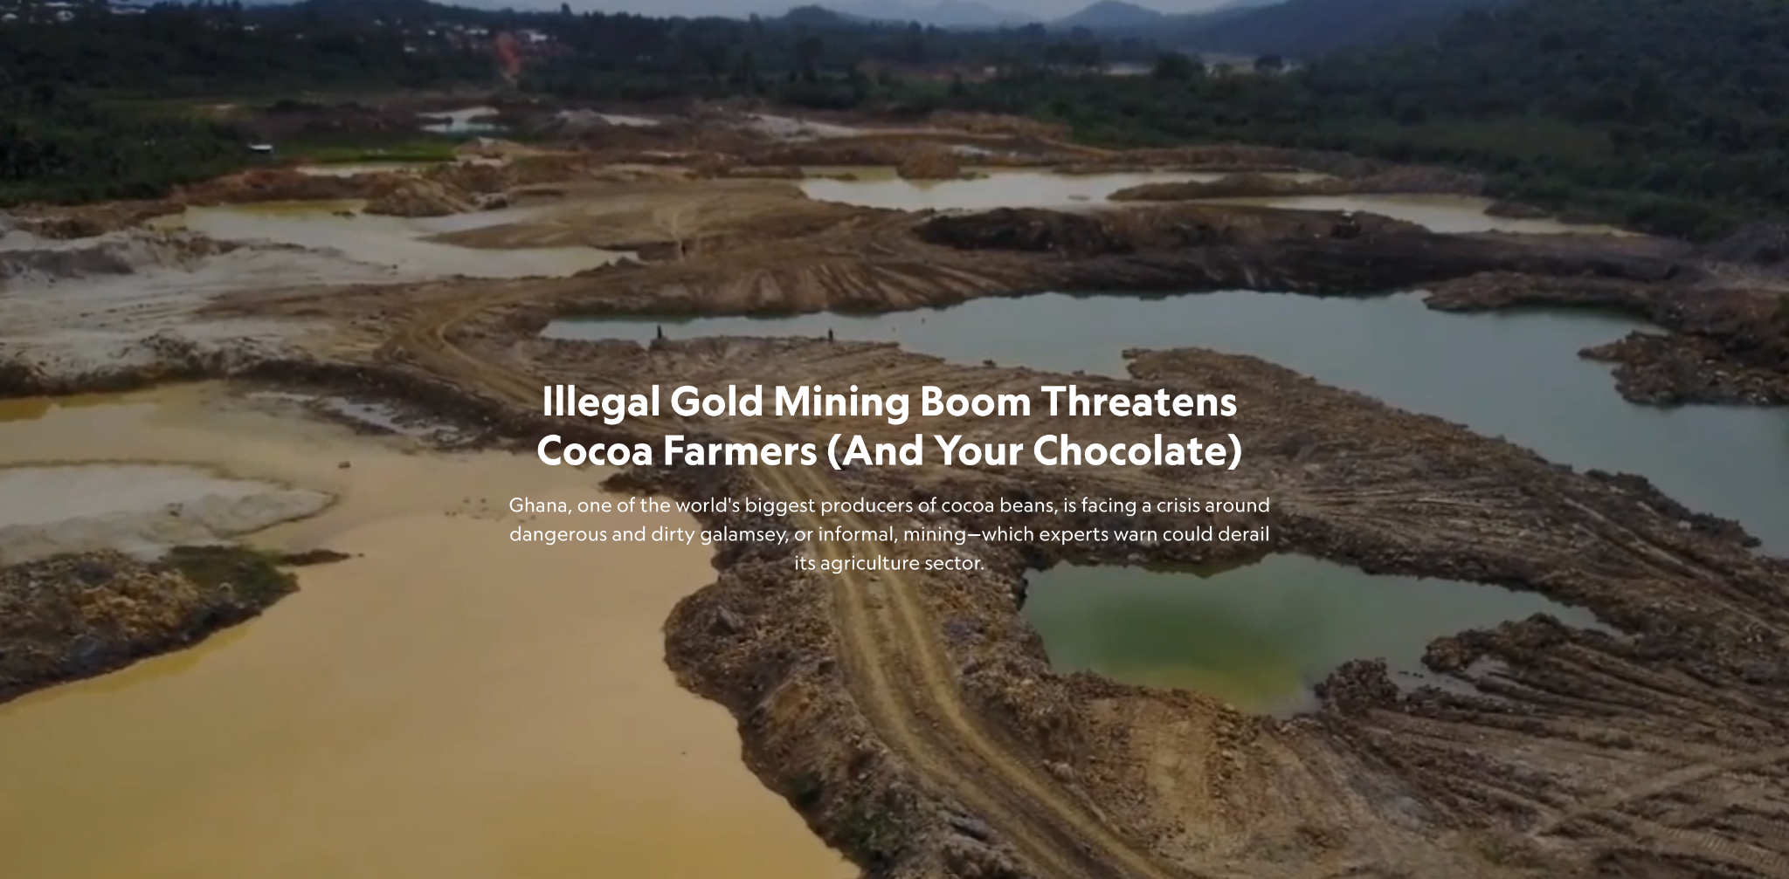
Motivation
Economic frictions affecting efficiency and sustainability
Transparency
Price disparities
Unsustainable farm practices
Alternative use of land
Regulatory measures to address the challenges
Certification systems
Source: National Geographic
Notes:
Harkin-Engel Protocol (Declaration)

Slide 4
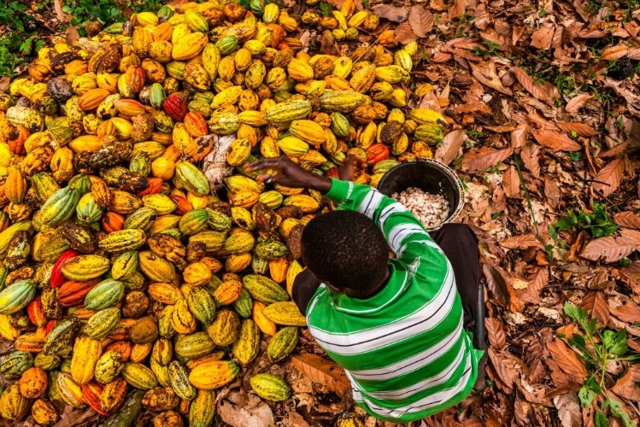
Motivation
Effect of certification on:
economic livelihood of farmers
land use
child labour
Notes:
Harkin-Engel Protocol (Declaration)
https://www.confectionerynews.com/Article/2019/07/15/The-Right-Price-Could-premiums-paid-by-the-government-eradicate-child-labor-in-Ghana-s-cocoa-industry

Slide 5
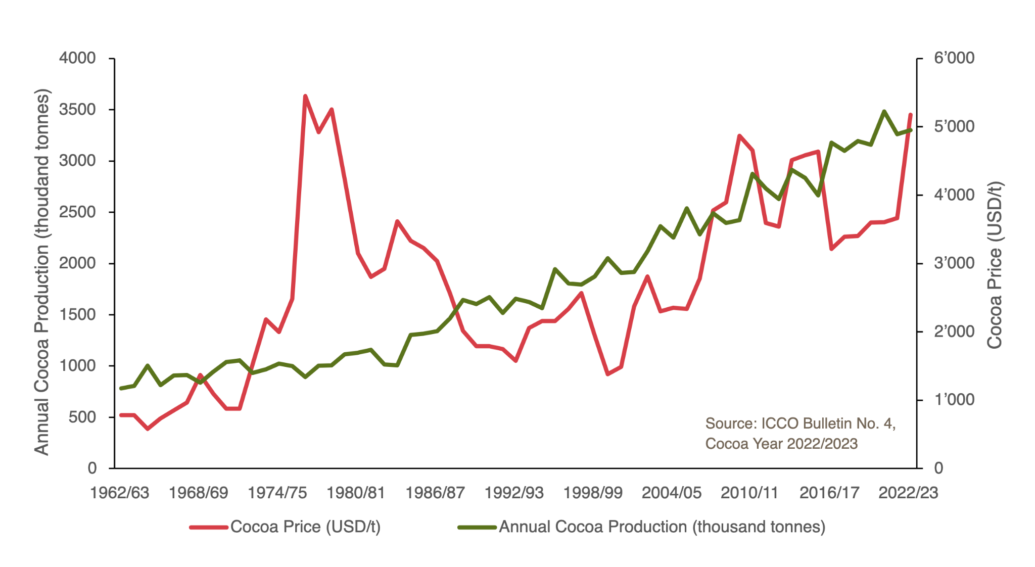
Institutional Setting
Ghana Cocoa
Global production
Export and foreign exchange
Political produce
Controlled system vs. Semi-liberalised
Living income differential ($400/MT)
Cocoa Sustainability Initiatives
Certifications (Rainforest and Fairtrade)
Cocoa Cooperatives
Other actors
Source: Swiss Platform for Sustainable Cocoa
Notes:
https://www.kakaoplattform.ch/about-cocoa/cocoa-facts-and-figures

Slide 6
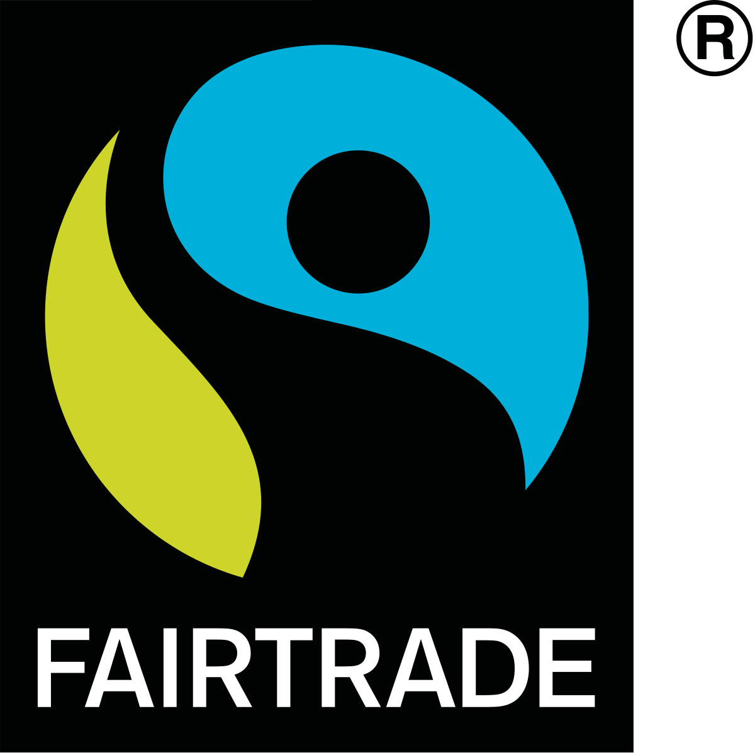
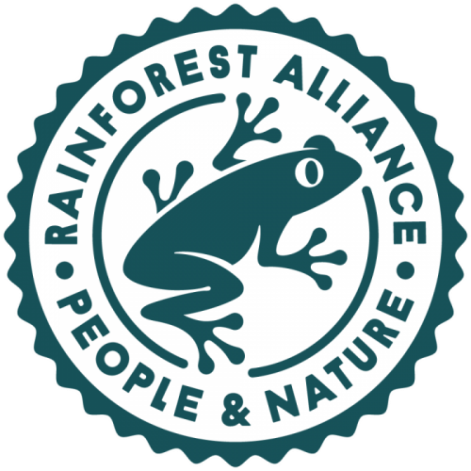

Cocoa Certification
Fairtrade
Fairtrade Minimum Price
Fairtrade Premium
Living income support
Farmer cooperatives
Prohibit dangerous agro-chemicals and GMOs
Child labor standards
Rainforest (now same as UTZ)
Reduce deforestation
Economic impact on farmers
Strengthen child labor oversight

Slide 7
FairTrade ≠ Rainforest Alliance
Standards | Fairtrade International | Rainforest Alliance
Guaranteed Minimum Price | ✓ | x
Fixed Premium for community projects | ✓ | x
Additional premium for organic farming | ✓ | x
Goal of Living Income for Farmers | ✓ | x
Farmer control of premium funds | ✓
Farmer ownership of standards | 50% | none
Democratic decision-making in farmer organizations | ✓ | x
Emphasis on collective bargaining for workers | ✓ | x
Source: Fair World Project
Notes:
https://fairworldproject.org/rainforest-alliance-is-not-fair-trade-2/

Slide 8
Extant Literature
Narrow studies on certification systems
Limited ground truth data and limited scope
Sustainability and agriculture commodities (cocoa, coffee, maize, etc)
Systematic differences in treated and control groups
Cooperatives
Limited focus on the mechanisms and the use of an economic theory to underpin the analysis
Policy surveys and research (for Harkin-Engel Protocol)

Slide 9
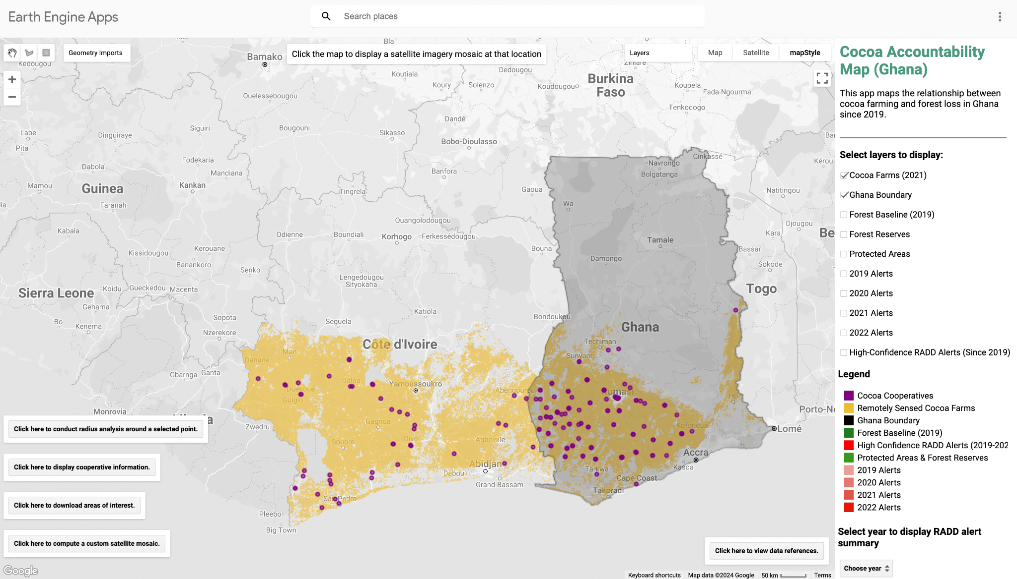
Data: Certification
Certification at the farm level
Fairtrade
Rainforest Alliance)
Farm level data from cocoa regulator

Slide 10
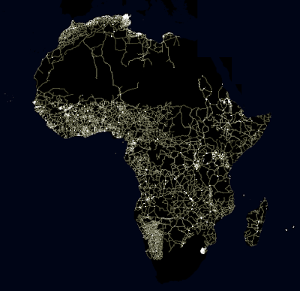
Data
Economic livelihood
Luminosity
Wage (based on demographic surveys)

Slide 11
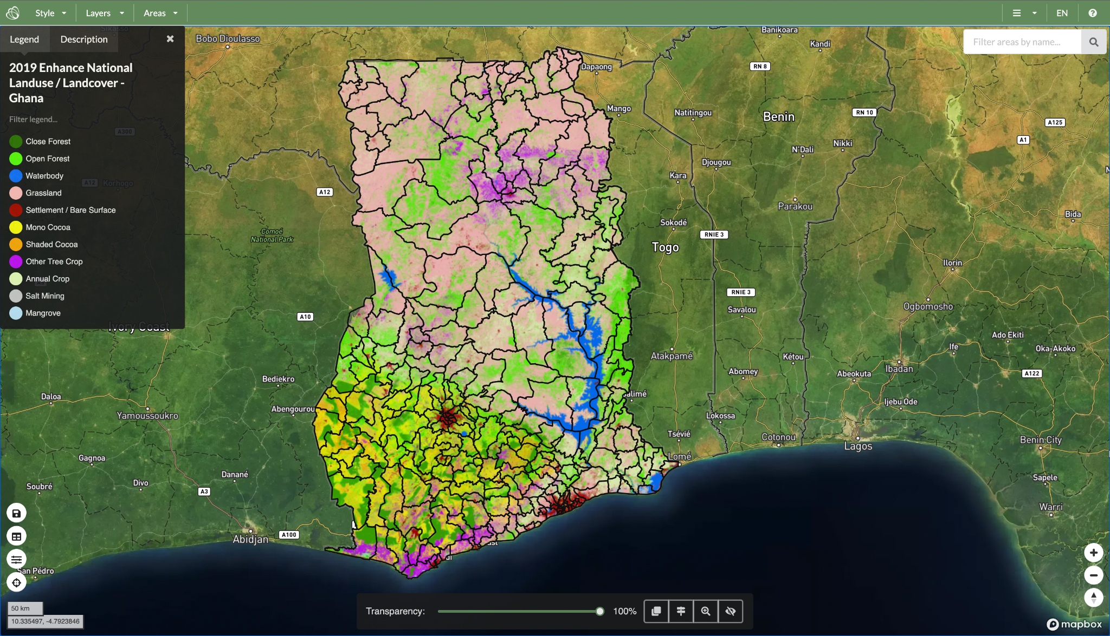
Data: Land Use
Land use
Deforestation
Illegal mining
Land cover for other crops

Slide 12
Data: Child Labour
Child labour
Education (administrative data and survey)
Education performance/results data
Child labour (survey)
National survey
ILO Survey
UNICEF Survey

Slide 13
Q&A

Slide 14
References
Bold, T., Ghisolfi, S., Nsonzi, F., & Svensson, J. (2022). Market Access and Quality Upgrading: Evidence from Four Field Experiments. American Economic Review, 112(8), 2518-2552.
Casaburi, L., & Reed, T. (2019). Interlinked Transactions and Competition: Experimental Evidence from Cocoa Markets. Unpublished.
De Janvry, A., Emerick, K., Gonzalez-Navarro, M., & Sadoulet, E. (2015). Delinking land rights from land use: Certification and migration in Mexico. American Economic Review, 105(10), 3125-3149.
Jorge Sellare & Eva‐Marie Meemken & Christophe Kouamé & Matin Qaim, 2020. "Do Sustainability Standards Benefit Smallholder Farmers Also When Accounting For Cooperative Effects? Evidence from Côte d'Ivoire," American Journal of Agricultural Economics, John Wiley & Sons, vol. 102(2), pages 681-695,
Kalischek, N., Lang, N., Renier, C., Daudt, R. C., Addoah, T., Thompson, W., ... & Wegner, J. D. (2023). Cocoa plantations are associated with deforestation in Côte d’Ivoire and Ghana. Nature Food, 4(5), 384-393.

Slide 15
Thank You

